Slide 1
Exploring a Career in
Early Childhood Education
Notes:
Today I’m going to talk about what a career in early childhood education looks like, degree and certificate options, as well as scholarship opportunities.

Slide 2
Table of Contents
Early Childhood Education Overview
A Career in Early Childhood Education
Career Paths & Education Requirements
Child Development Associate Credential
Michigan Youth Development Associate Credential
TEACH Early Childhood® Michigan Scholarships
Next Steps
This project was supported by funding provided from the Michigan Department of Lifelong Education, Advancement and Potential (MiLEAP) utilizing American Rescue Plan Act (ARPA) funding, from the Office of Child Care, Administration for Children and Families, U.S. Department of Health and Human Services.
Notes:
Here is an overview of what we’re going to cover in today’s presentation:
What is early childhood education
Why choose a career in early childhood education
Career paths and education
The Child Development Associate credential
The Michigan Youth Development Associate credential
The TEACH Early Childhood® Michigan scholarship program and opportunities
And next steps!
Let’s get started!

Slide 3
Early Childhood Education Overview
What is early childhood education?
  A career focused on helping young children, birth through age 8, learn and grow during their most vital years.
It’s a path for those with a passion for children.
Notes:
Let’s start by talking about what is early childhood education.
It’s a career focused on helping young children learn and grow in the earliest years of their lives.
We usually define early childhood from birth through age eight.
This is a great path for anyone who loves working with children and who wants to make an impact on the minds of young people.

Slide 4
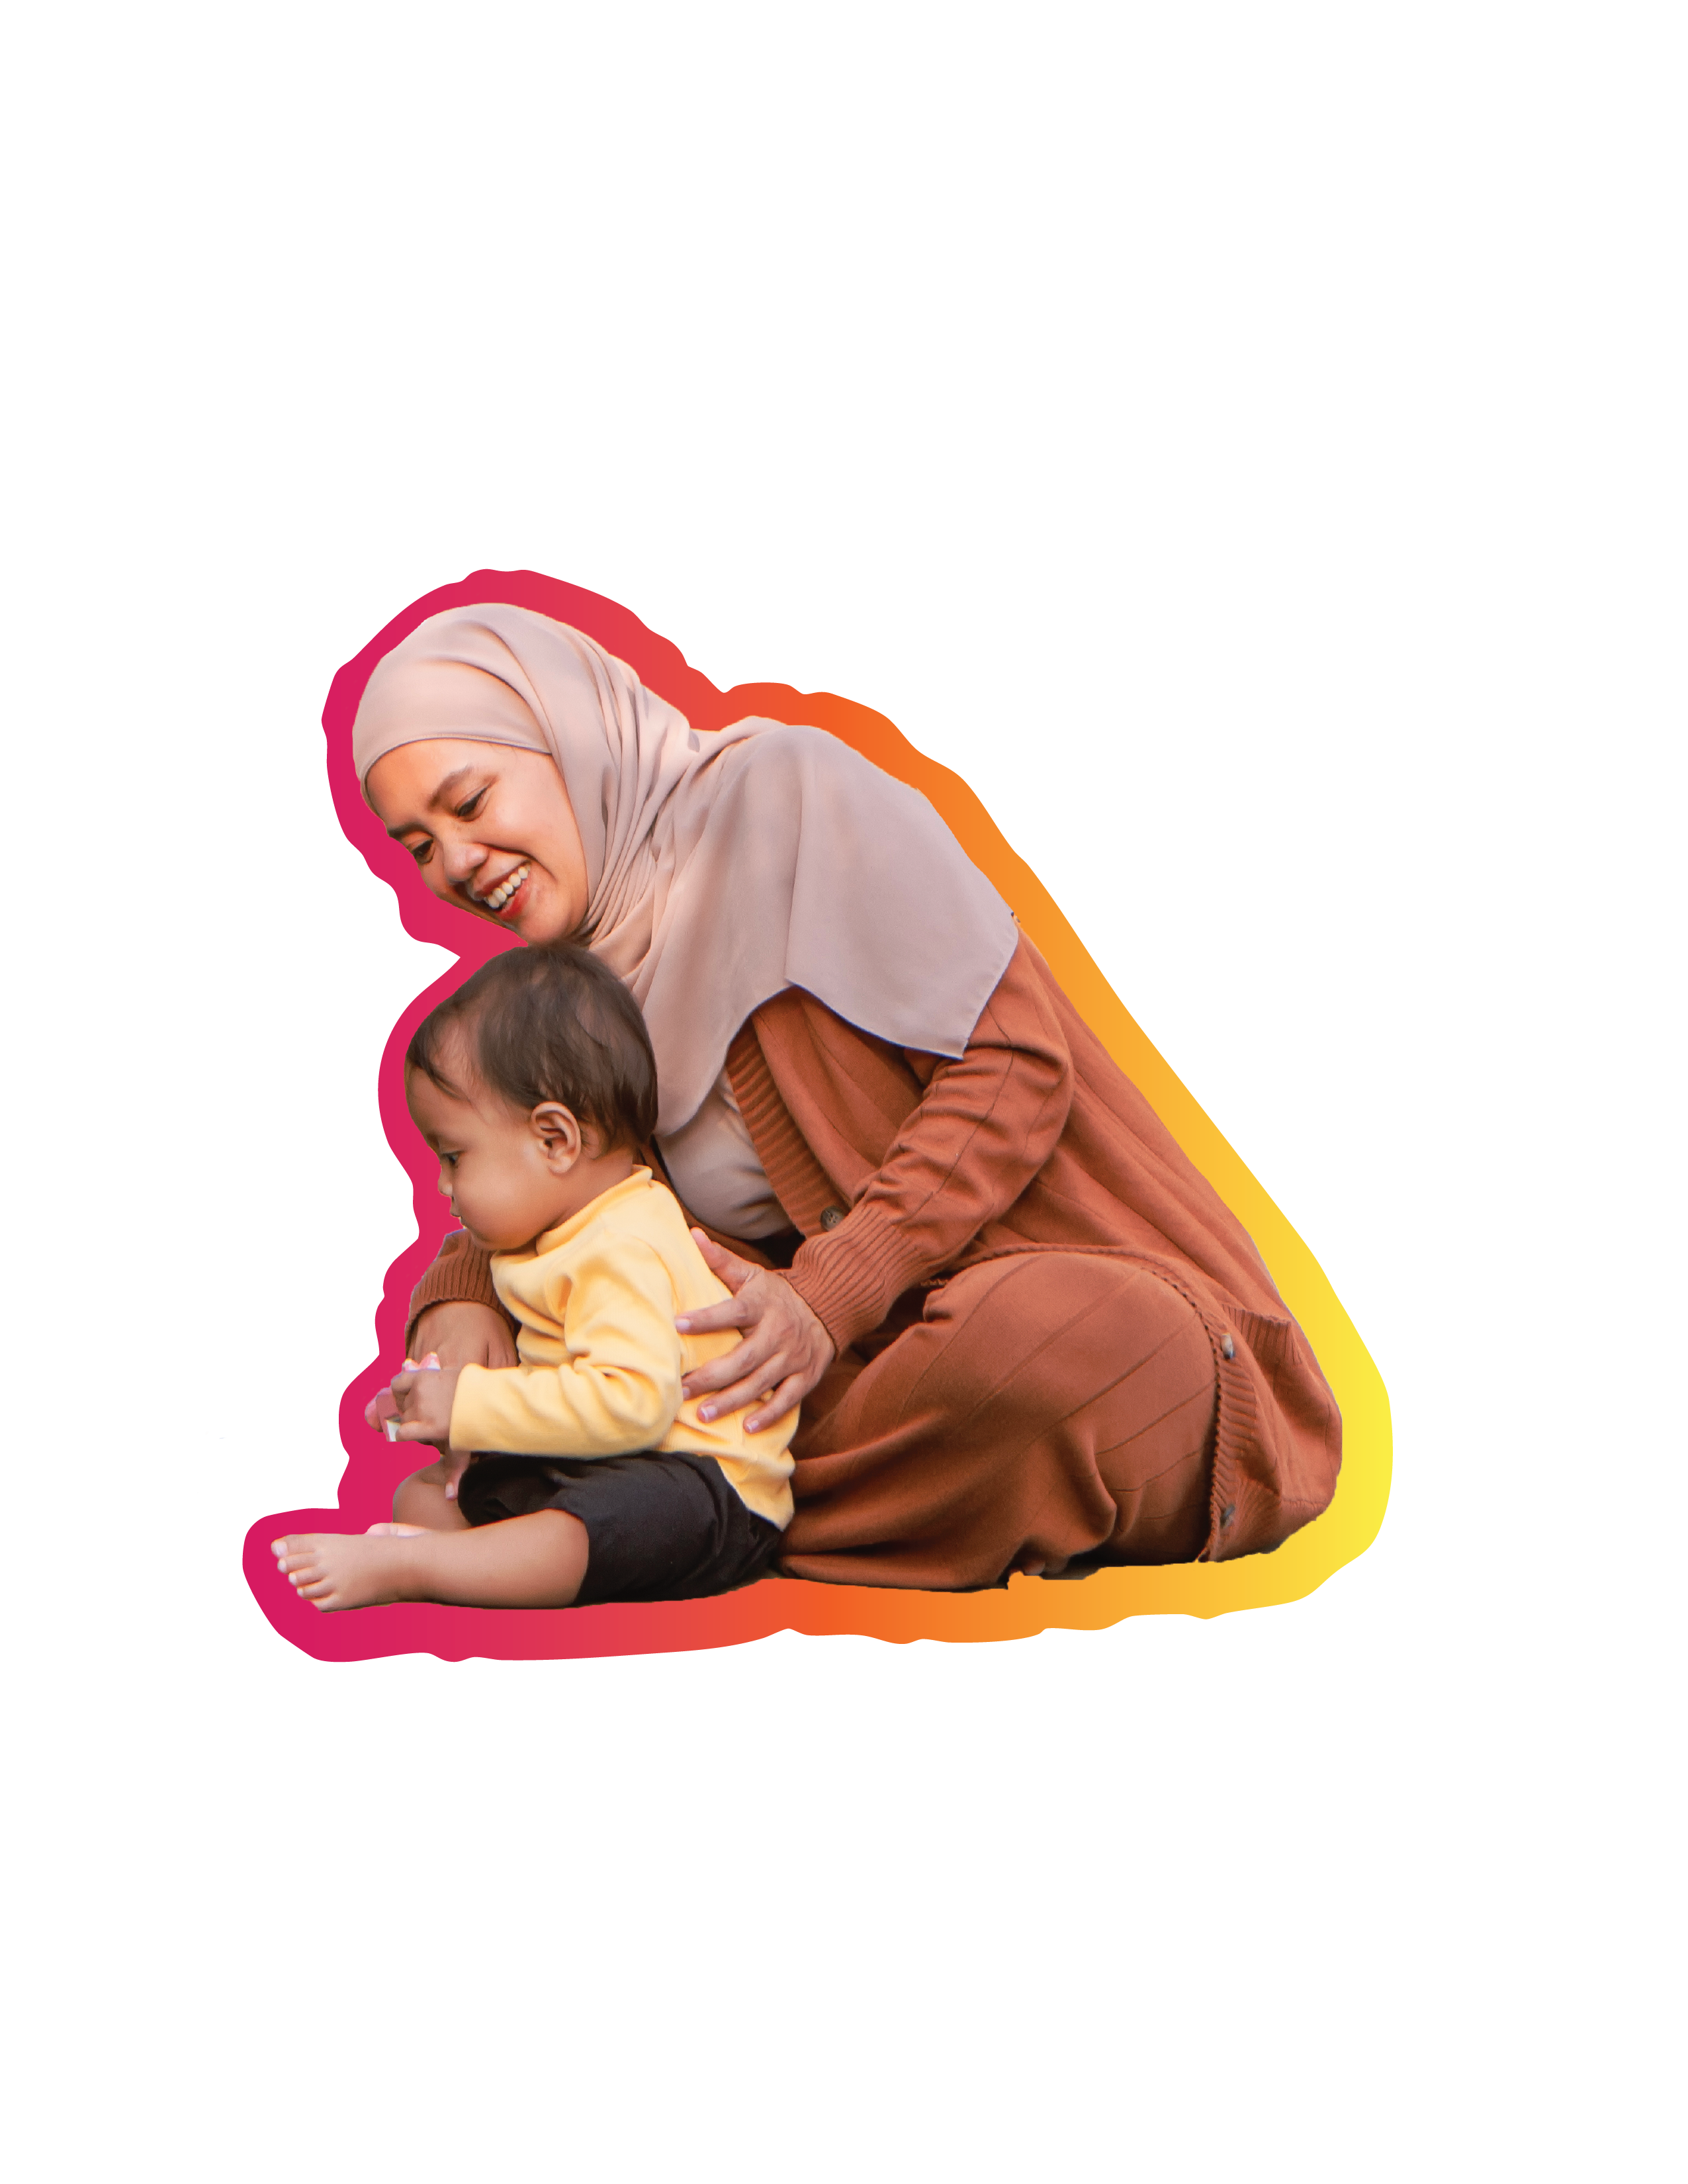
A Career in Early Childhood Education
Why choose a career in early childhood education?
Make a lasting impact in the lives of young children.
Work with a passionate community of people.
Experience the daily joys of childhood.
Explore diverse career paths.
Notes:
Why should someone choose a career in early childhood education? Well, there are many reasons!
You can make a lasting impact on a child’s life during the most vital development years.
You get to work with a community of people who are passionate about their work. It takes a special group of people to be early childhood educators!
You get to experience the daily joys of childhood. Think of those little giggles as children play and learn or the beloved macaroni art! You get to be part of that daily fun and exploration.
A career in early childhood has many different career paths — from childcare center workers to directors, team leaders and preschool teachers. The options are endless!

Slide 5
Career Paths & Education Requirements ⁽¹⁾
Career paths
  Preschool teacher
  Child care curriculum coordinator
  Family support specialist
  Child care center administrator
  Special education teacher
  Lead teacher and more
Notes:
Let’s dive into those diverse careers paths, as well as the education options for early childhood education.
First, let’s talk about career options. You could work in everything from a preschool to a child care center or referral agency and so much more!
There are also numerous education paths you could choose from including:
The Child Development Associate credential
The Michigan Youth Development Associate credential
An associate’s degree
A bachelor’s degree
Or a master’s degree
Let’s dive into a couple of these a little deeper.

Slide 6
Career Paths & Education Requirements ⁽²⁾
Education paths
  Child Development Associate (CDA) credential
  Michigan Youth Development Associate
  (MI-YDA) credential
  Early Childhood
  Registered Apprenticeship
  Associate degrees
  Bachelor’s degrees
  Master’s degrees
Notes:
Let’s dive into those diverse careers paths, as well as the education options for early childhood education.
First, let’s talk about career options. You could work in everything from a preschool to a child care center or referral agency and so much more!
There are also numerous education paths you could choose from including:
The Child Development Associate credential
The Michigan Youth Development Associate credential
An associate’s degree
A bachelor’s degree
Or a master’s degree
Let’s dive into a couple of these a little deeper.

Slide 7
Child Development Associate (CDA) Credential
Nationally recognized certification for working with children ages birth
through age 5.
Great, affordable career starting point.
Requirements
  High school diploma or be a high school junior/senior enrolled in an early education/child development career and technical program.
  Complete 120 hours of professional education.
  Complete 480 hours of hands-on experience with young children.
  Prepare a professional portfolio showcasing your experiences and work in early childhood education.
Cost and funding
  Assessment fee: $425
  TEACH Early Childhood® Michigan can cover 85-100% of the cost.
Notes:
The Child Development Associate or CDA is the first credential I want to talk about.
It’s a nationally recognized certification for working with children ages birth through age 5.
It’s a great and affordable place to start your career in early childhood education.
The requirements for the credential are:
You must have a high school diploma or be a high school junior or senior who is enrolled in an early education or child development career and technical program.
You must complete 120 hours of professional education.
You must complete 480 hours of hands-on experience with young children.
And you must prepare a portfolio to showcase your experiences and work in early childhood education.
The CDA credential is extremely affordable as well. The assessment fee is $425, but there are scholarship opportunities through TEACH Early Childhood that can cover up to 85% of the cost of the assessment.

Slide 8
Michigan Youth Development Associate (MI-YDA) Credential
State-recognized credential for working with children from ages 5 and up.
Great preparation for roles in out-of-school programming and youth development.
Requirements
  High school diploma or be a high school junior/senior enrolled in an early education/child development career and technical program.
  Be certified in first aid, adult/child CPR and blood-borne pathogen training.
  Be a member of the Michigan Afterschool Partnership or National Afterschool Association.
  Complete 120 hours of educational training.
  Complete 480 hours of hands-on experience with youth.
Cost and funding
  Assessment fee: $299
  TEACH Early Childhood® Michigan can cover 85-100% of the cost.
Notes:
The next credential is the Michigan Youth Development Associate or MI-YDA.
This is an affordable path into working with school-aged children.
The MI-YDA credential is state-recognized for working with children from ages five and above.
It is great preparation for working in roles in out-of-school programming and youth development.
The requirements for the credential are:
You must have a high school diploma or be a high school junior or senior who is enrolled in an early education or child development career and technical program.
You must be currently certified in First Aid, Adult/Child CPR and bloodborne pathogene training.
You must maintain membership in the Michigan Afterschool Partnership or National After School Association.
You must complete 120 hours of educational training.
You must complete 480 hours of hands-on experience with youth.
And you must prepare a portfolio to showcase your experiences and work in early childhood education.
The MI-YDA credential is extremely affordable as well. The assessment fee is $299, but there are scholarship opportunities through TEACH Early Childhood that can cover up to 85% of the cost of the assessment.

Slide 9

TEACH Early Childhood Michigan Scholarships
TEACH is a statewide scholarship program for early childhood education.
Scholarship support for:
  Certifications
  Classes
  Assessments
  Degrees
Various education levels
are covered:
  CDA
  MI-YDA
  Associate degree
  Bachelor’s degree
  Master’s degree
Visit miaeyc.org/t-e-a-c-h-scholarships/
to learn more.
Notes:
One of the great parts of pursuing an early childhood education career is the financial support available.
The TEACH Early Childhood Michigan scholarship program is a statewide program specifically for early childhood education.
Scholarships covering a number of things including:
Certifications
Classes
Assessments
And degrees
And the scholarships cover a variety of education levels including:
CDA
MI-YDA
An associate’s degree
A bachelor’s degree
Or a master’s degree
Visit the Michigan Association for the Education of Young Children website to learn more about the TEACH scholarships available.

Slide 10
Next Steps
Your career in early childhood education awaits!
Start exploring your opportunities today …
Make an appointment with your counselor to talk about careers in early childhood education or visit miaeyc.org/t-e-a-c-h-scholarships/ to learn more about funding your early childhood educational path with a TEACH scholarship.
Notes:
Now that you know more about early childhood education and what opportunities await you, I encourage you to explore it more!
Connect with a counselor today to talk about your interests or visit the Michigan AEYC website to learn more about any of these options.

Slide 11
Thank you!
Notes:
Today I’m going to talk about what a career in early childhood education looks like, degree and certificate options, as well as scholarship opportunities.

