Slide 1
Organic Social Post 1:
Post Graphic
Speaking to parents & students
Post Copy:
For the Class of 2024, winning a year of free pizza* is as easy as pie!
🍕 To enter, just fill out the newly simplified FAFSA (no essay
required!) by June 30, then text FAFSA to 1-844-34-PIZZA.
*Visit www.ReachForThePie.org for complete rules.
#MIStudentAid #CollegeBoundMI #FAFSA #FreePizza
#FreePizzaForAYear #ReachForThePie
YY-CLIENT-####

Slide 2
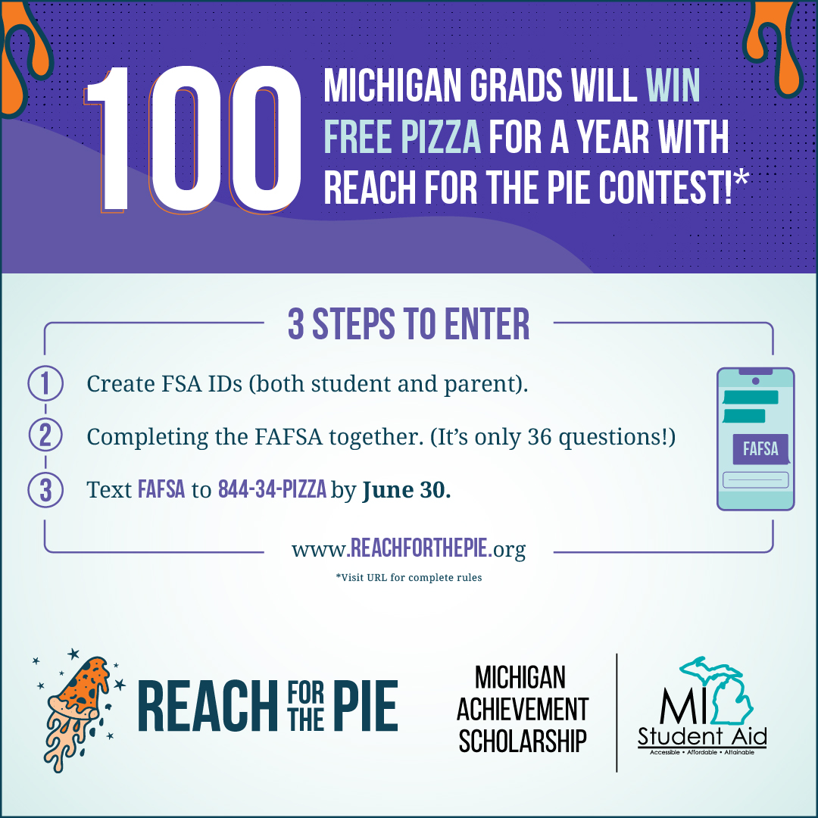
Organic Social Post 2:
Post Graphic,
For schools to share with parents & students
Post Copy:
The Reach for the Pie contest is giving the Class of ’24 the chance to
follow their dreams and win free pizza 🍕 for a year* just by filling out
their FAFSA and texting FAFSA to 1-844-34-PIZZA by June 30.
Graduating seniors who’ve already completed the FAFSA are still
eligible. Just text to enter.
*Visit www.ReachForThePie.org for complete rules.
#MIStudentAid #CollegeBoundMI #FAFSA
YY-CLIENT-####

Slide 3
Organic Social Post 3:
Post Graphic,
For partners/stakeholders to share with parents & students
Post Copy:
The Reach for the Pie contest is giving graduating Michiganders
another reason to fill out the FAFSA: A year of free pizza!* 🍕 All they
have to do is complete their FAFSA by June 30, then text FAFSA to
1-844-34-PIZZA. Time is running out to enter! Share this post and
spread the word to help students gain access to federal, state and
college-specific loans, grants, work-study programs and scholarships!
*Visit www.ReachForThePie.org for complete rules.
#MIStudentAid #CollegeBoundMI #FAFSA #FreePizza
#FreePizzaForAYear #ReachForThePie
YY-CLIENT-####

